Slide 1

Rocker Timesheet
User Guide
Odoo version 15

Slide 2
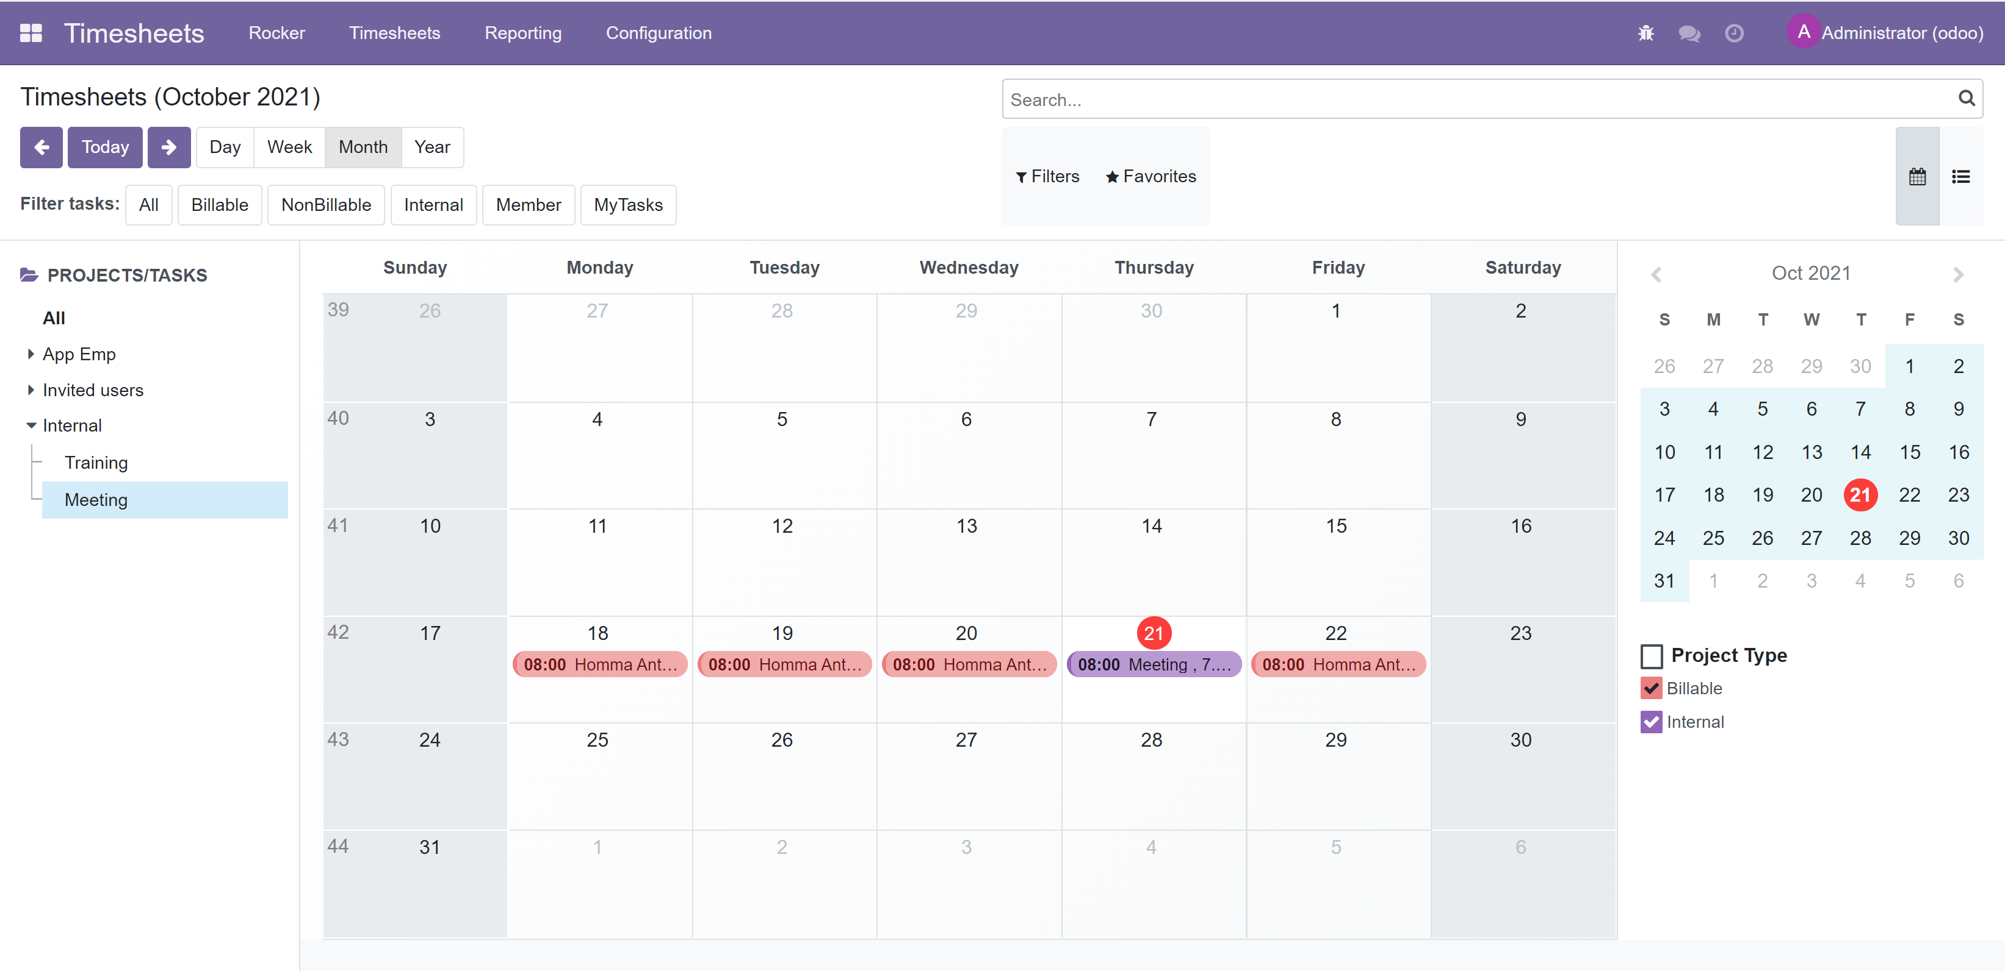
Rocker Timesheet / Calendar view
Calendar views
Calendar view /List view
Project/Task Filters
List of Projects/task

Slide 3
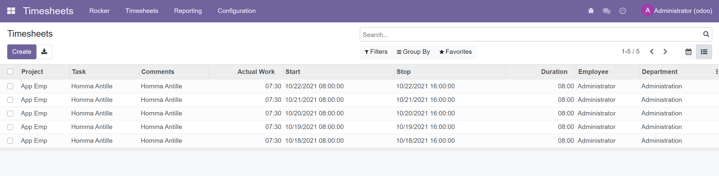
Rocker Timesheet / List view
Calendar view /List view
List of Timsheets
Rocker List has Actual work, Start (time), End (Time) & Duration

Slide 4
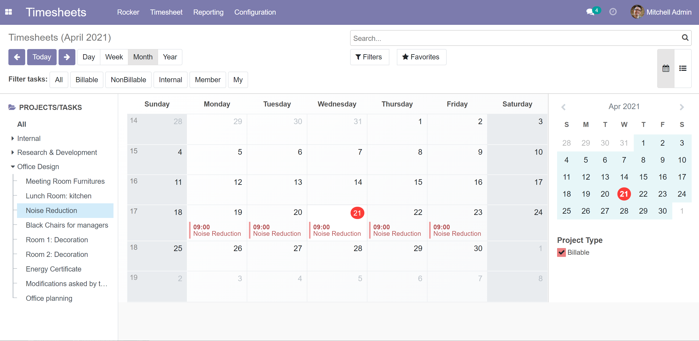
Add timesheet rows / report work done
Click calendar and while holding mouse down select all days needed
Select one of the Tasks.
If you select a Project, then Project and Task is empty in opening dialog (you can select those from drop-downs in the dialog)

Slide 5
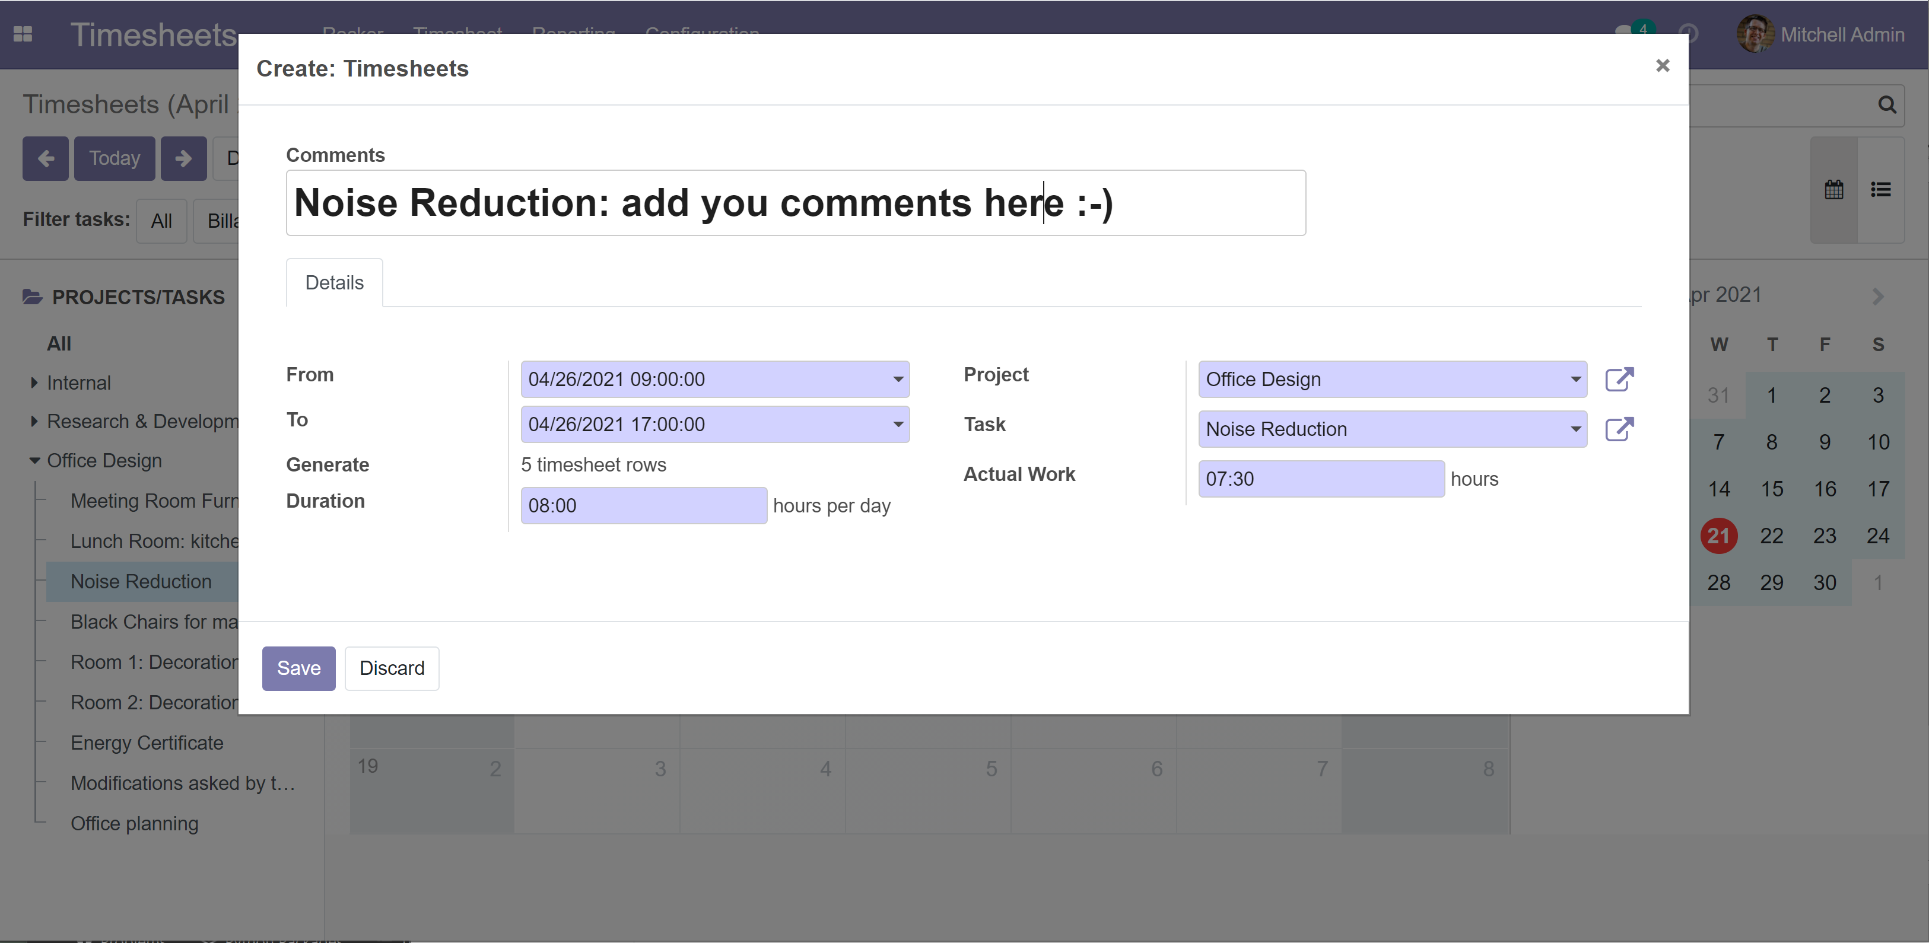
Add timesheet rows / report work done
Selected days
If you selected more than one day, this one tels how many report rows is generated
You can change duration and work amount. (these comes from Company defaults or User defaults, see separate slide)

Slide 6
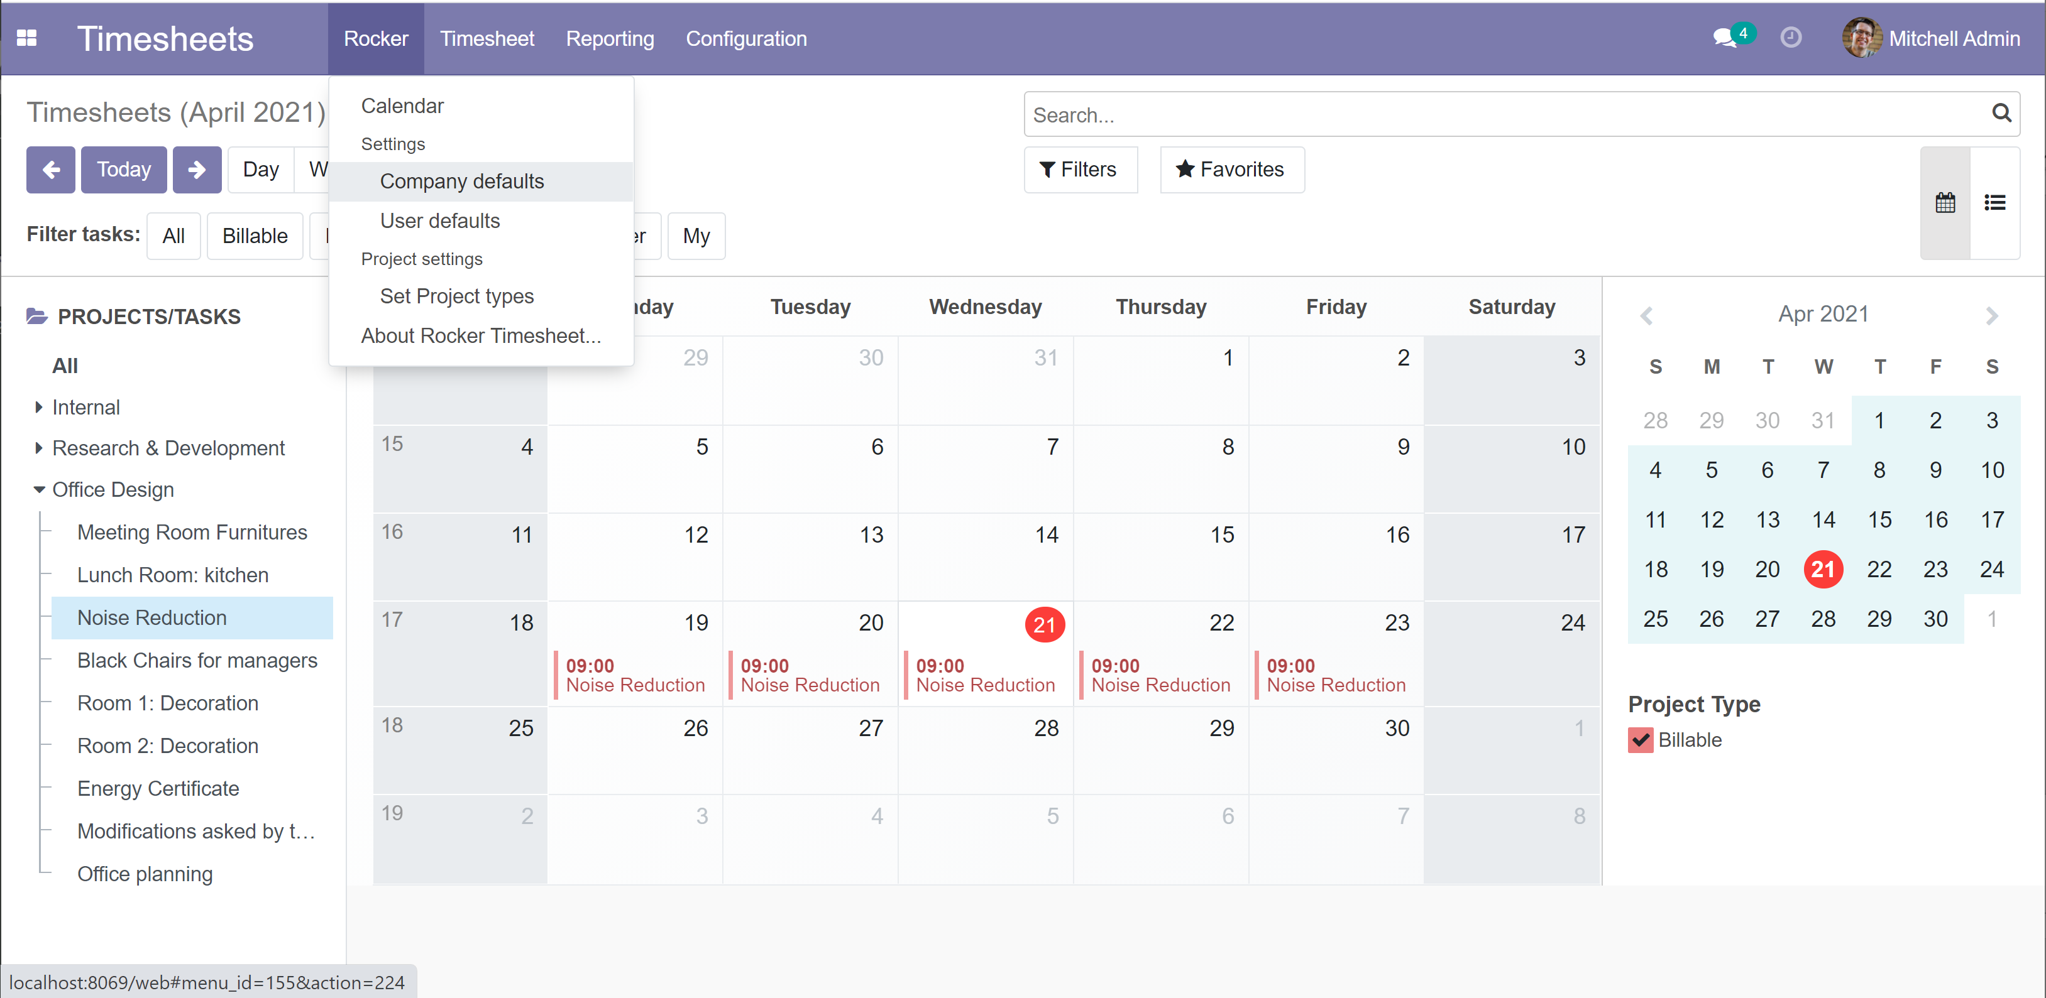
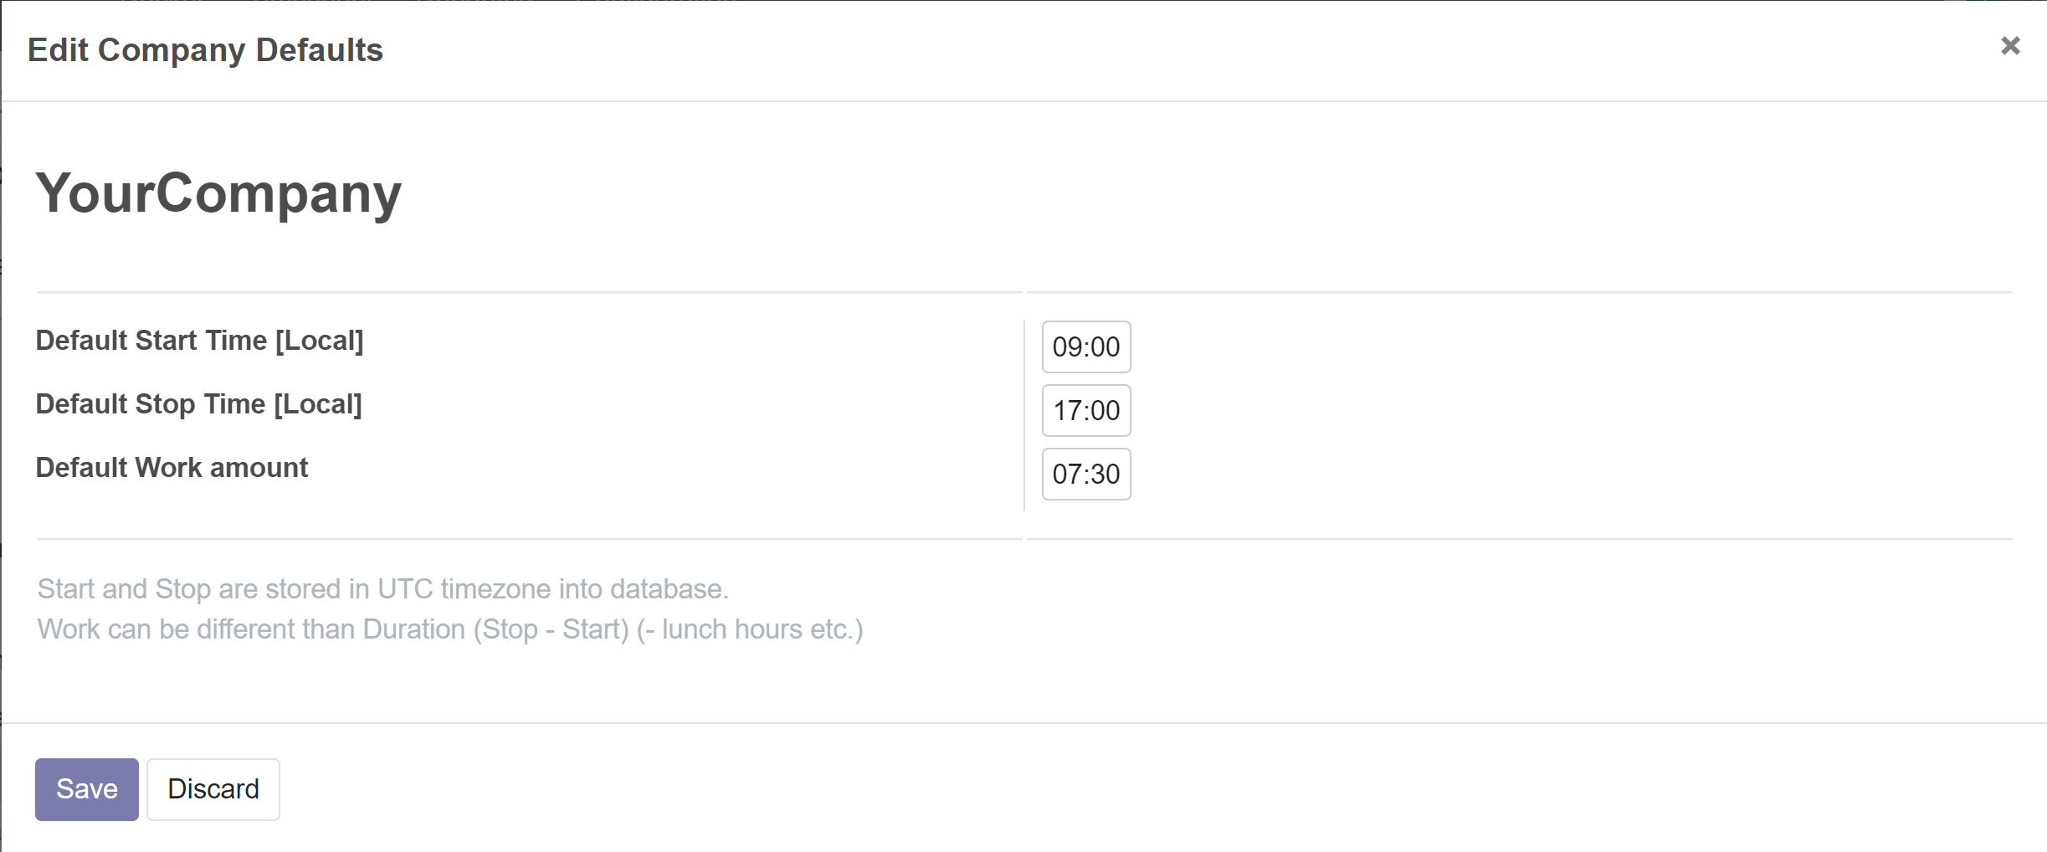
Company defaults
You need to be Administrator for changing company defaults
Verify your timezone before updating these figures. Times are stored in UTC but shown here in you local timezone
Thios is the default work amount to be reported. Duration is calculated from Stop - Start
Odoo has quite complicated working calendar for users (morning working hours, afternoon working hours, different odd weeks etc.) but rocker uses this simplified ☺

Slide 7
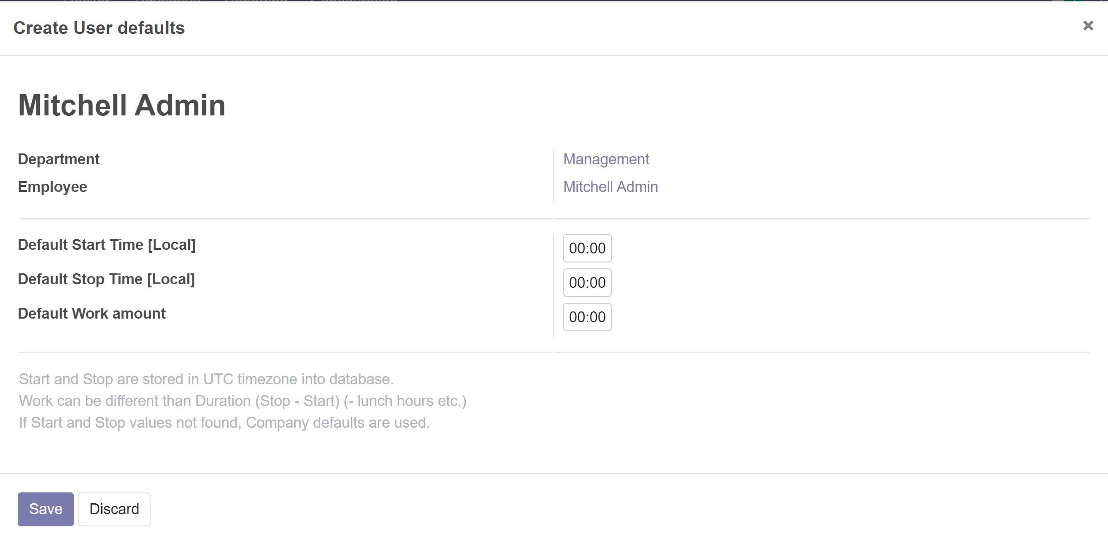
User defaults
If user has not created defaults for him/her self, then company defaults are used
User defaults
Verify your timezone before updating these figures. Times are stored in UTC but shown here in you local timezone
This is the default work amount to be reported. Duration is calculated from Stop - Start
Odoo has quite complicated working calendar for users (morning working hours, afternoon working hours, different odd weeks etc.) but rocker uses this simplified ☺

Slide 8
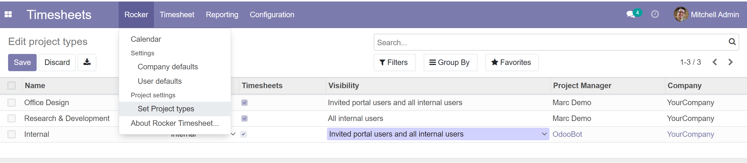
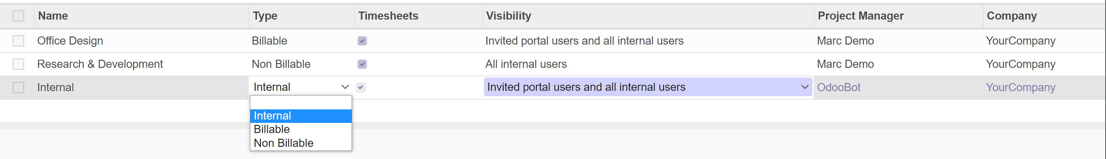
Project types & visibility
Select Timesheets if you allow to report work for the Project
These are for Project/Task filtering
Project visibility to users. You can change here but if you need special access to selected users, change it in Project views

Slide 9
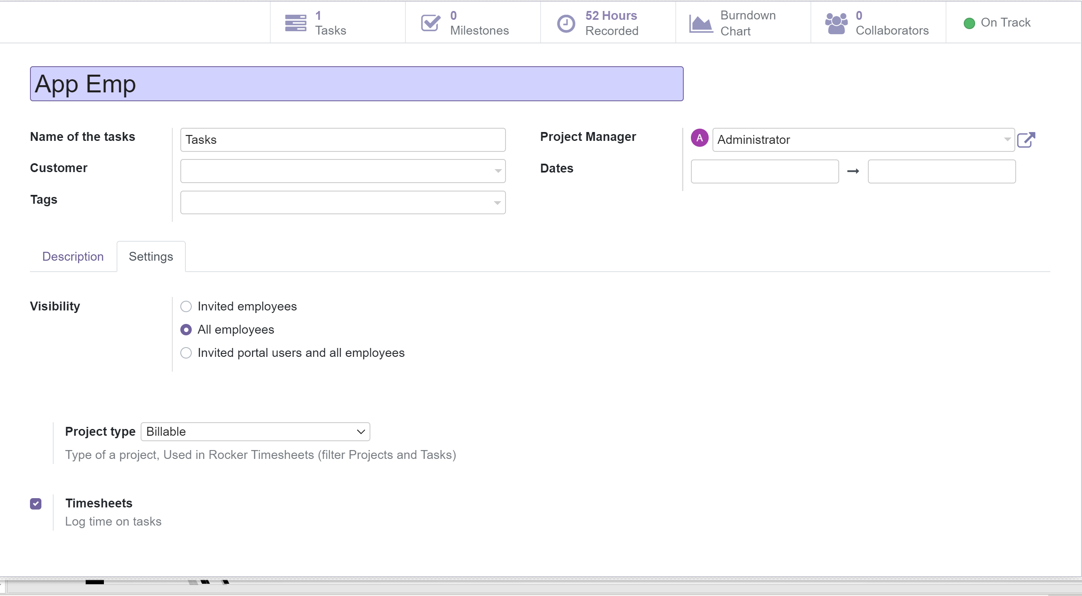
Project/Task visibility
Invited employees: Users following can see this
All employees: All users can see this project
Allow timesheets

Slide 10
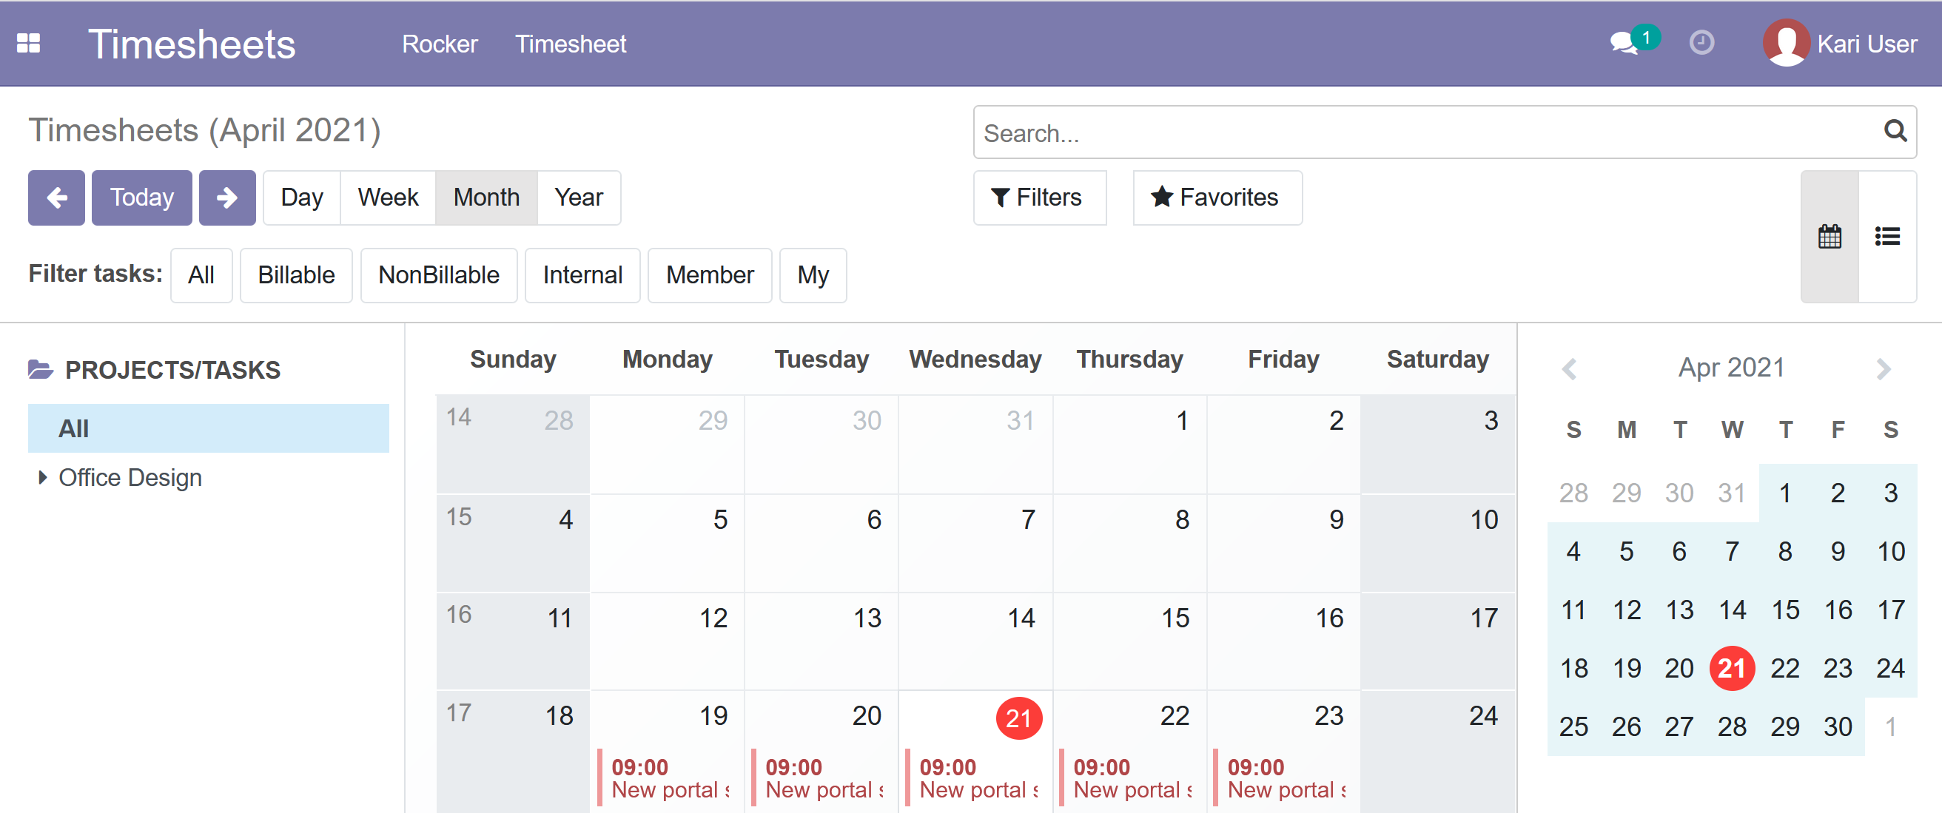
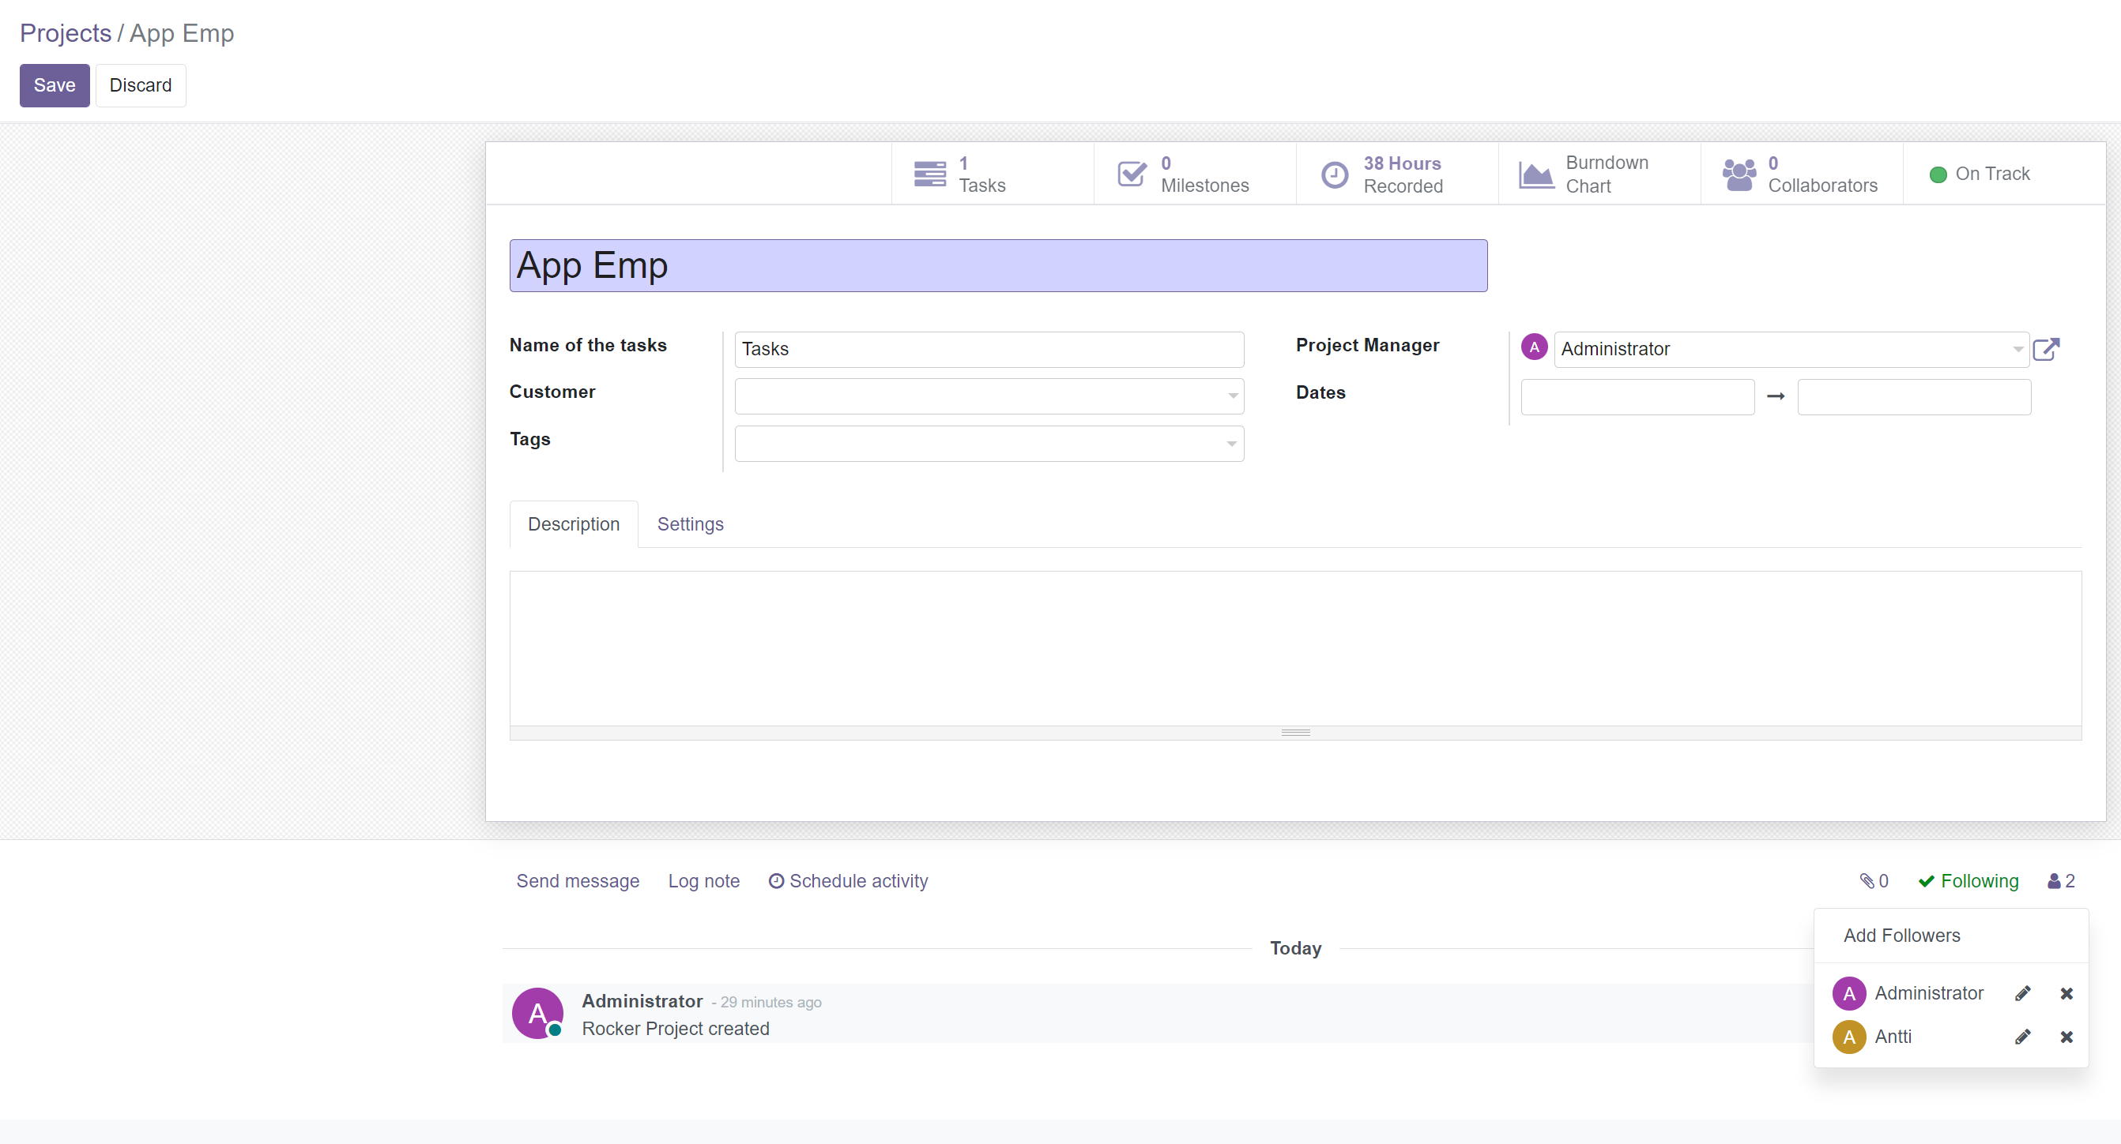
Project/Task visibility
Click Member filter
Project Members
Only projecs where you are Follower

Slide 11
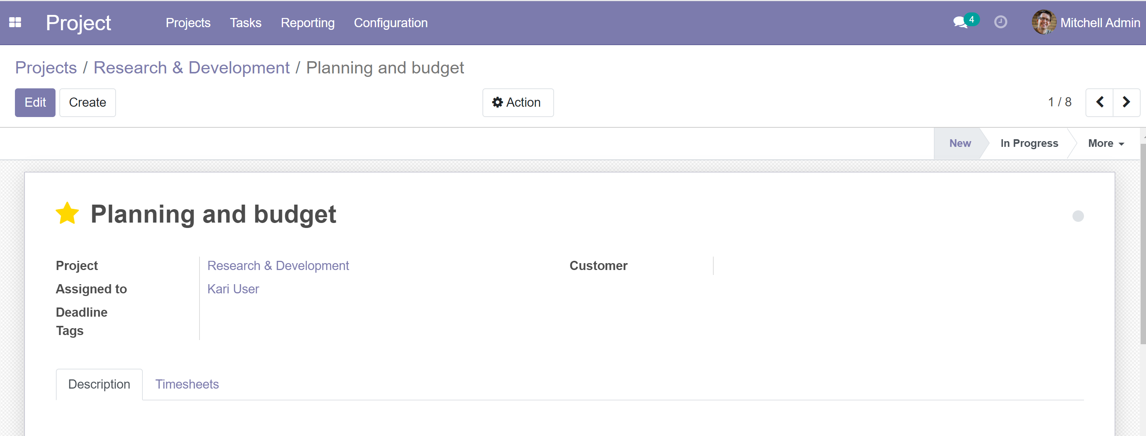
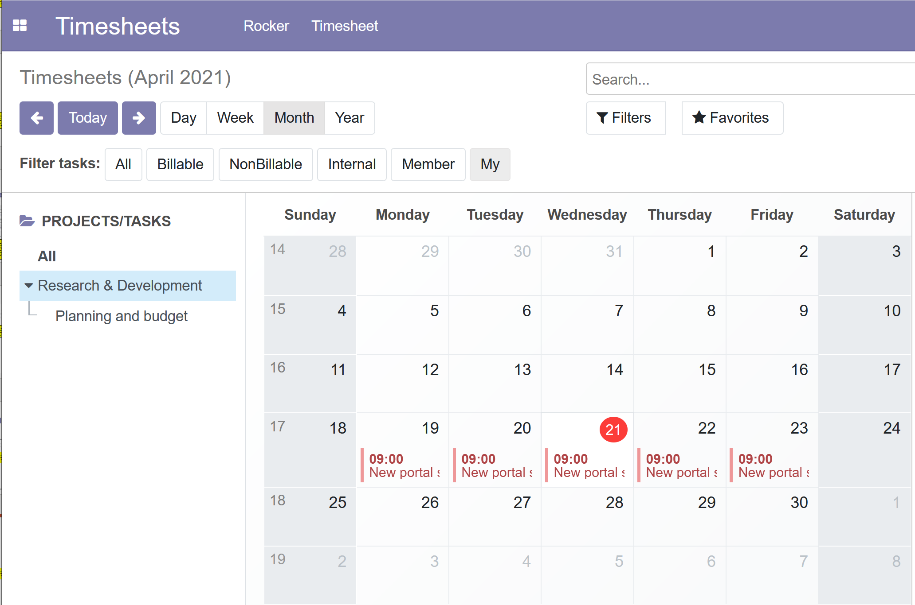
Project/Task visibility
Click My filter
Project Task assigned to user
Only tasks where you are in Assigned To

Slide 12
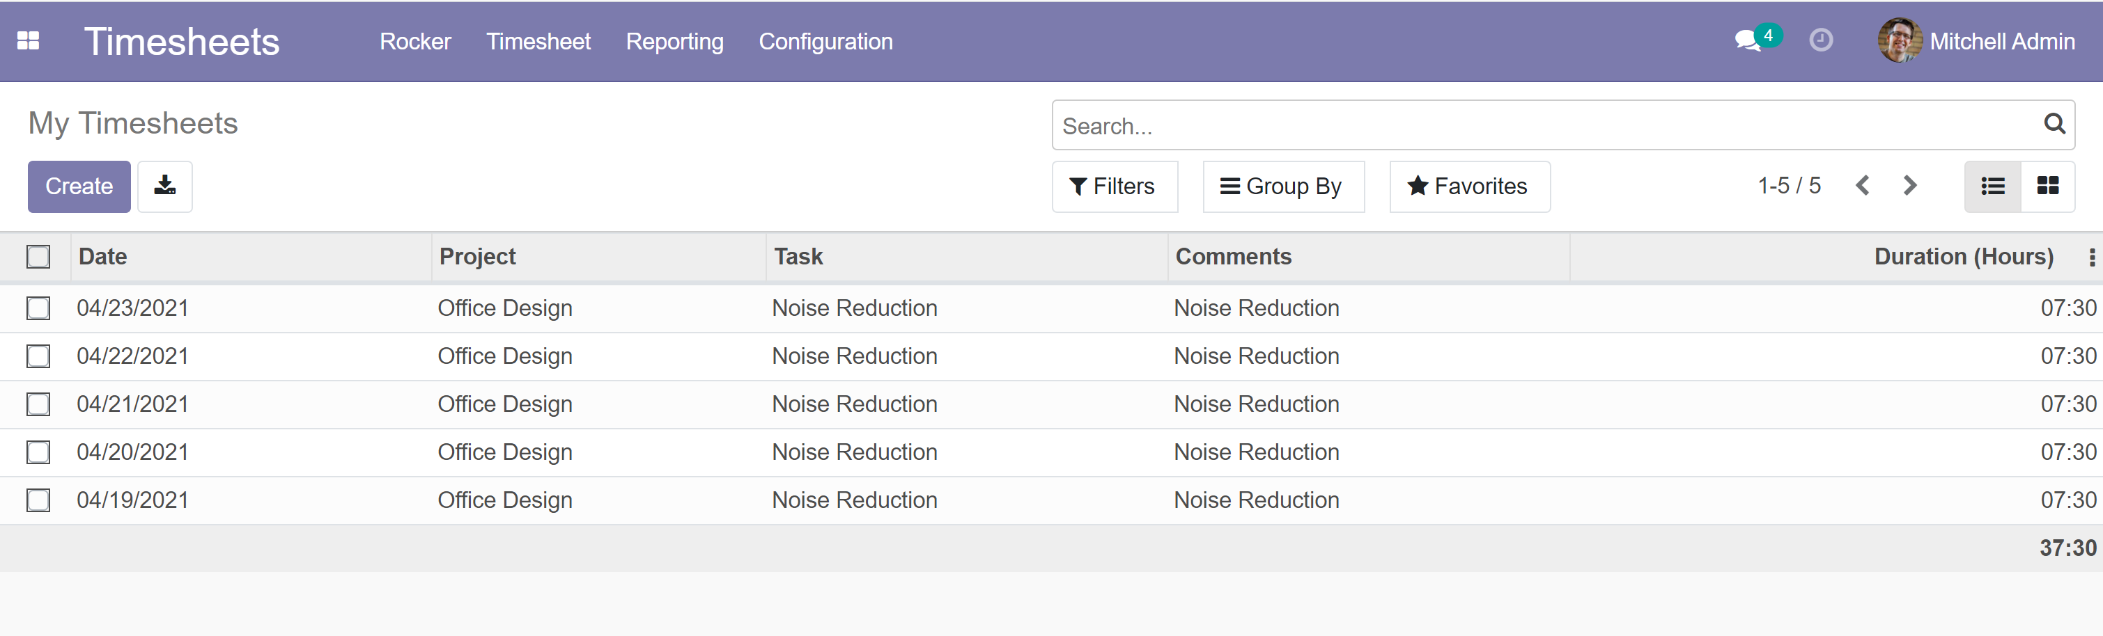
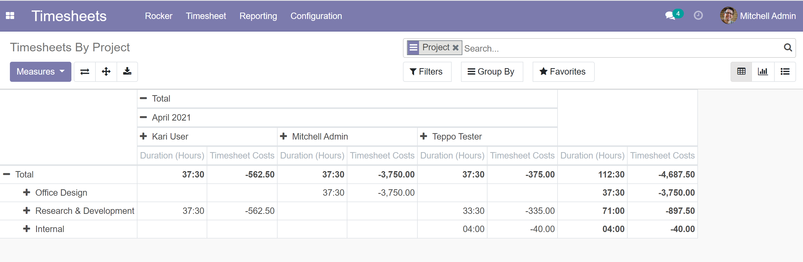
Hr_timesheet
Work_amount in Rocker side (not duration, duration contains lunch hours which are not payable
All rows generated in Rocker side are visible in hr_timesheet module
All hr_timesheet module & project modul reports are usable

Slide 13
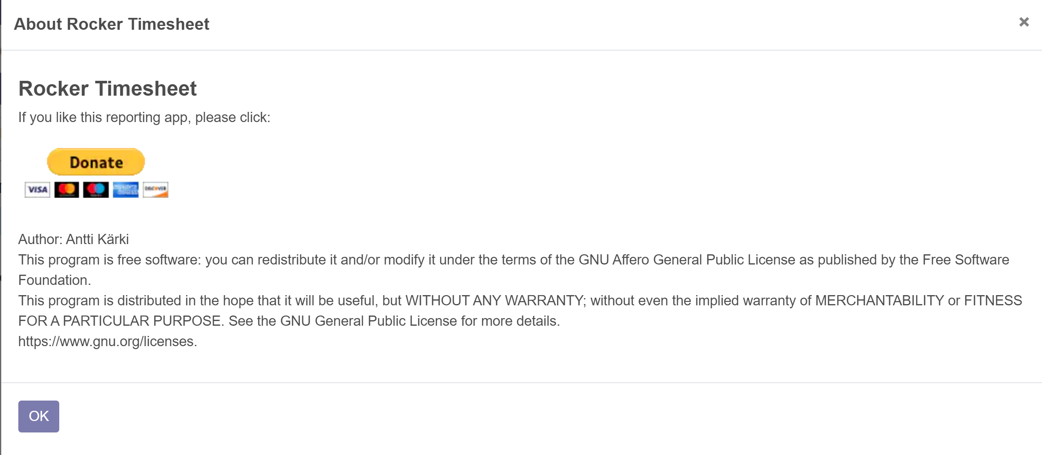
Remember to Click Donate

